Slide 1
An Introduction
earthkit 1.0 training session

Slide 2
What is earthkit-plots?
earthkit-plots is the core visualisation component of earthkit.
earthkit-plots makes visualisation quick and easy with:
  a concise, high-level API
  intelligent formatting based on metadata
  complex grids supported out-of-the-box
  customisable style libraries
Notes:
Most dependencies are optional, so you don’t have to install them unless you need them

Slide 3
Why develop visualisation tools at all?
There are many fantastic Python libraries for data visualisation: matplotlib, Cartopy, bokeh, Plotly, HoloViews, seaborn, Magics, metview, and more.
earthkit-plots is not a new visualisation library - it is a domain-specific high-level library that wraps lower-level tools to drastically reduce the boilerplate needed for earth-science visualisation.
The goal is to let scientists focus on their science, not on the mechanics of plotting.
Notes:
Most dependencies are optional, so you don’t have to install them unless you need them

Slide 4
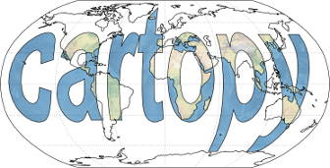

Software stack
earthkit-plots uses earthkit-data to understand earth science datasets and matplotlib and cartopy to visualise them.
It has a very high-level API which hides complexity and greatly reduces boilerplate code.
Notes:
Most dependencies are optional, so you don’t have to install them unless you need them

Slide 5
Software stack
Building on top of widely adopted open-source tools allows us to maintain less and benefit from an existing, well-documented API.
Notes:
Most dependencies are optional, so you don’t have to install them unless you need them

Slide 6
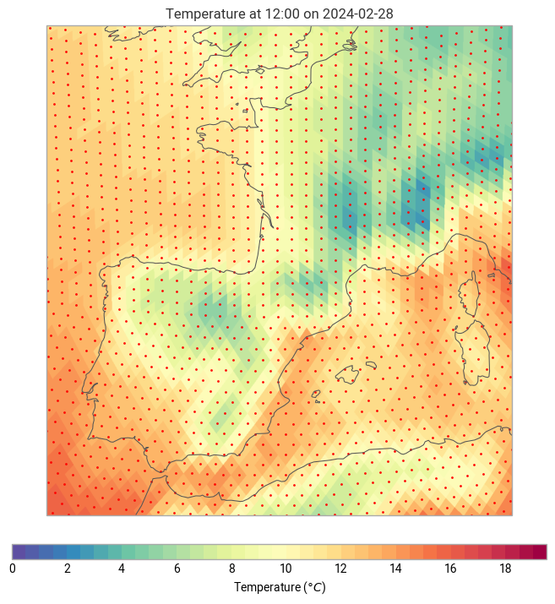
How does earthkit-plots make plotting easier?
High-level functions do a lot with a little bit of code
Domain-specific knowledge powers metadata formatting, unit conversion, automatic styles and more
Complex grids (HEALPix, reduced Gaussian, ORCA etc.) are supported out-of-the-box
Style libraries improve consistency of visualisations & branding
Notes:
Most dependencies are optional, so you don’t have to install them unless you need them

Slide 7
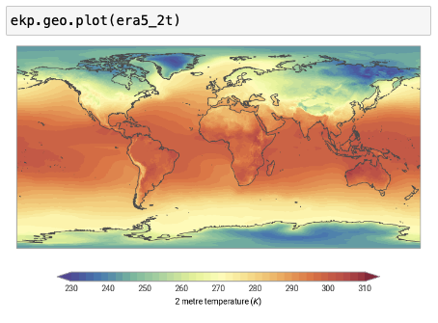
Ultra-high-level API
You can do a lot with a single line of code.
High-level API makes the “best attempt” at plotting data, including automatic styles.
That data can be GRIB, netCDF, xarray or NumPy arrays.
Notes:
Most dependencies are optional, so you don’t have to install them unless you need them

Slide 8
Ultra-high-level API
You can do a lot with a single line of code.
You do not need to extract coordinates or variables from your data: earthkit-plots does that automatically.
Notes:
Most dependencies are optional, so you don’t have to install them unless you need them

Slide 9
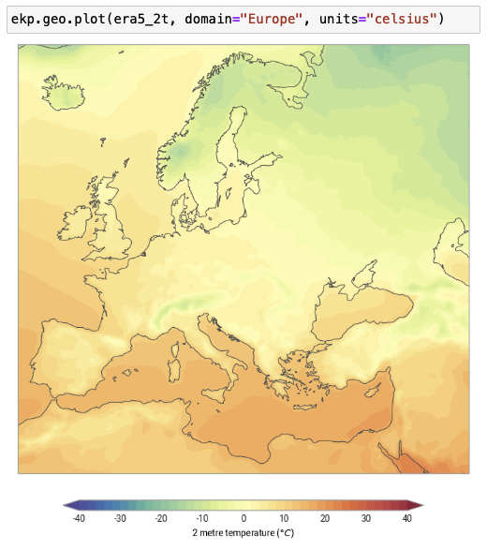
Domain and units
You can pass a domain and units to any plot to quickly tweak it to your needs.
By leveraging earthkit-data’s understanding of data sources, we can do things like unit conversion on-the-fly.
Notes:
Most dependencies are optional, so you don’t have to install them unless you need them

Slide 10
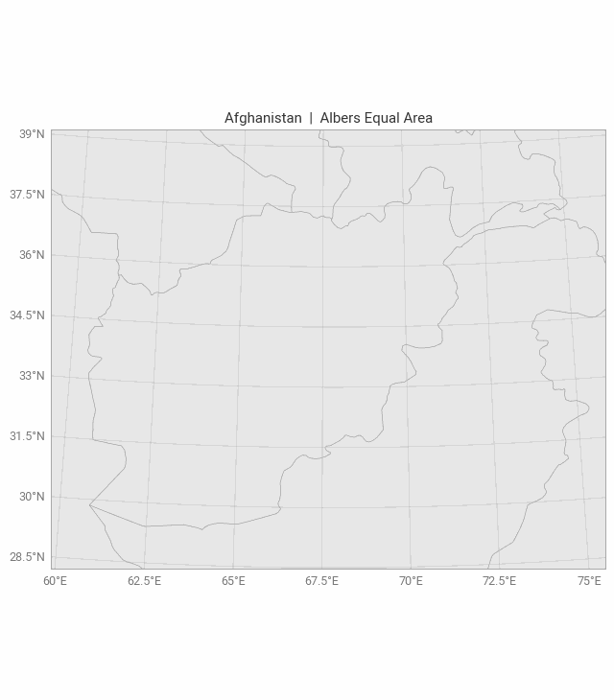
Domains
There are almost 200 built-in domains (mostly named countries and continents) with optimised map projections.
You can also easily pass your own custom domains.
Notes:
Most dependencies are optional, so you don’t have to install them unless you need them

Slide 11
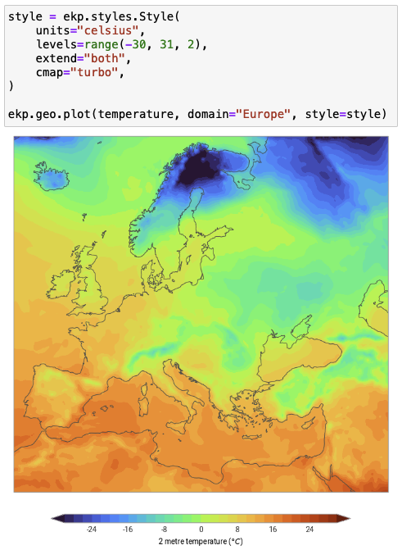
Styles
Styles define how your data is visualised.
Mostly accept standard matplotlib arguments and can include units.
Easily reusable and reduce cognitive load of plotting methods…
…but plotting methods still accept standard matplotlib arguments.
Notes:
Most dependencies are optional, so you don’t have to install them unless you need them

Slide 12
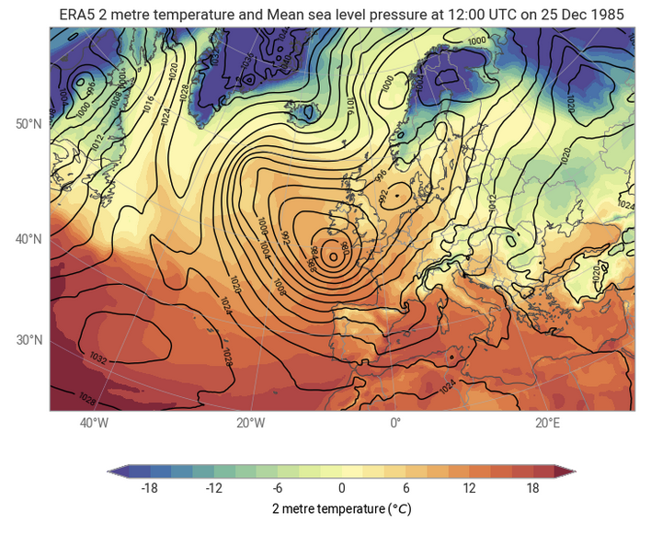
Metadata formatting
Extract metadata directly in your titles, legend, axes labels and annotations.
Makes it far easier to write reusable code which adapts to your data.
Notes:
Most dependencies are optional, so you don’t have to install them unless you need them

Slide 13
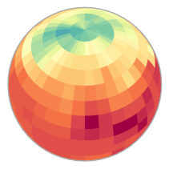
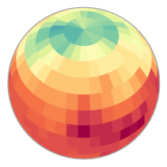
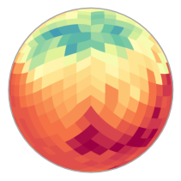
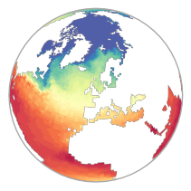
Grids
earthkit-plots is underpinned by earthkit-geo to make plotting complex grids (like Gaussian, HEALPix or ORCA grids) as easy as plotting regular latitude-longitude grids.
Notes:
Most dependencies are optional, so you don’t have to install them unless you need them

Slide 14
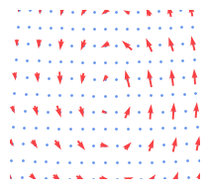
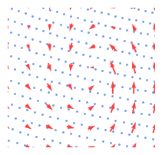
Resampling
A high-level Pythonic API for quickly subsampling or interpolating data before plotting
Notes:
Most dependencies are optional, so you don’t have to install them unless you need them

Slide 15
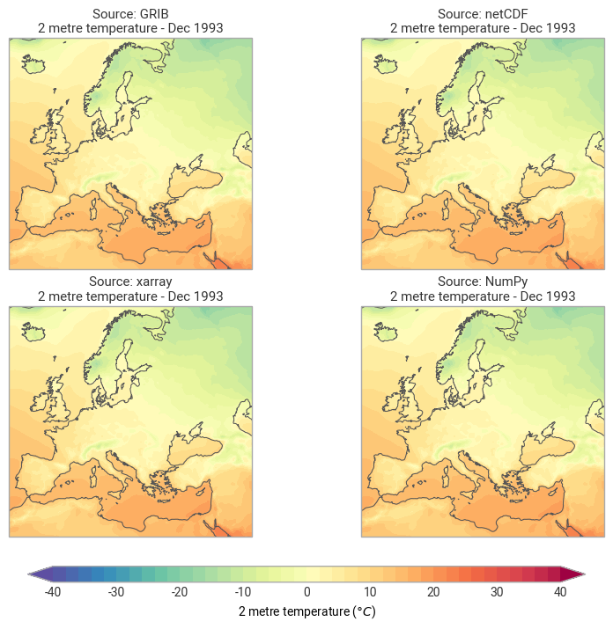
Source types
Since earthkit-data understands many different sources – GRIB, netCDF, xarray, NumPy and more – so does earthkit-plots!
Plotting each source uses one consistent API
Notes:
Most dependencies are optional, so you don’t have to install them unless you need them

Slide 16
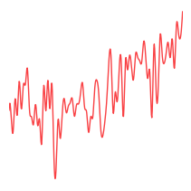
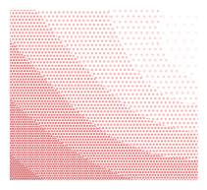
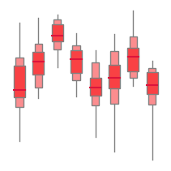
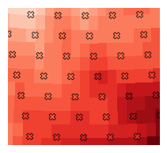
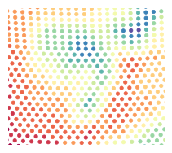
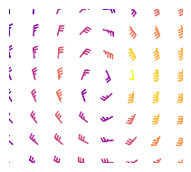
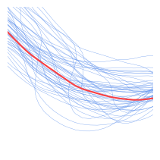

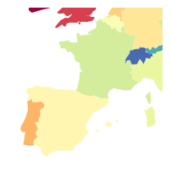
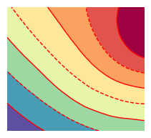
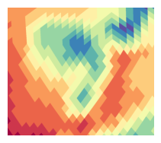
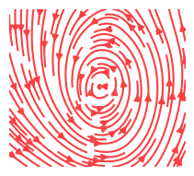
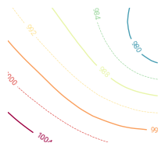
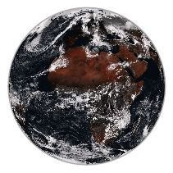
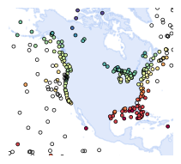
Plot types
Beyond standard meteorological plots, earthkit-plots has built-in methods for plotting RGB composite plots, choropleth maps, meteograms, climate stripes and more.
Notes:
Most dependencies are optional, so you don’t have to install them unless you need them

Slide 17
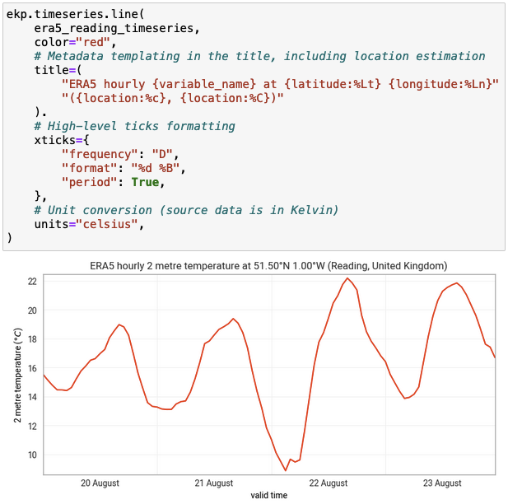
It’s not just maps…
Features like unit conversion, metadata templating, and high-level APIs apply to other plot types too!
Notes:
Most dependencies are optional, so you don’t have to install them unless you need them

Slide 18
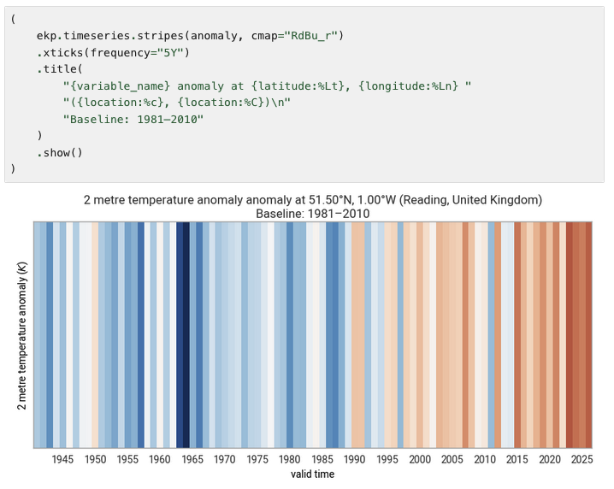
It’s not just maps…
Features like unit conversion, metadata templating, and high-level APIs apply to other plot types too!
Notes:
Most dependencies are optional, so you don’t have to install them unless you need them

Slide 19
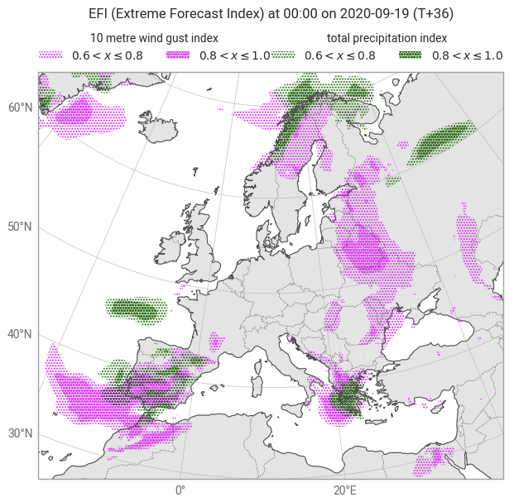
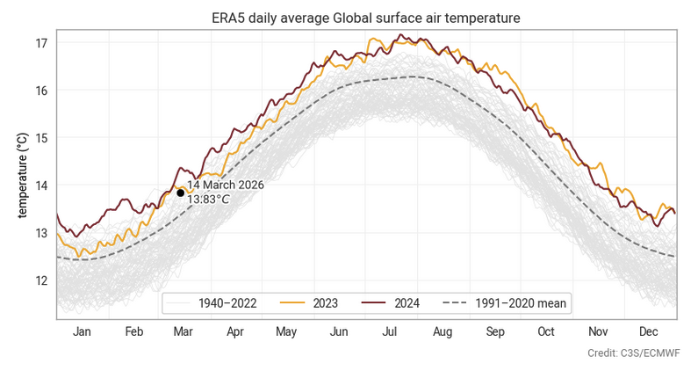
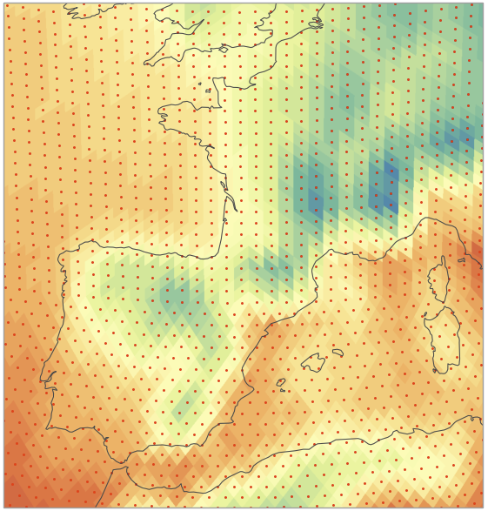
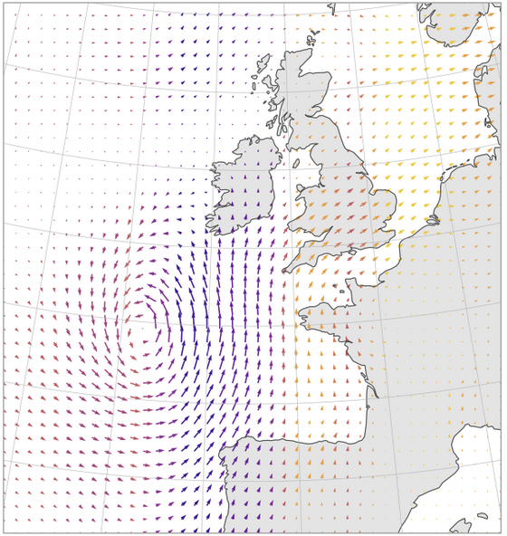
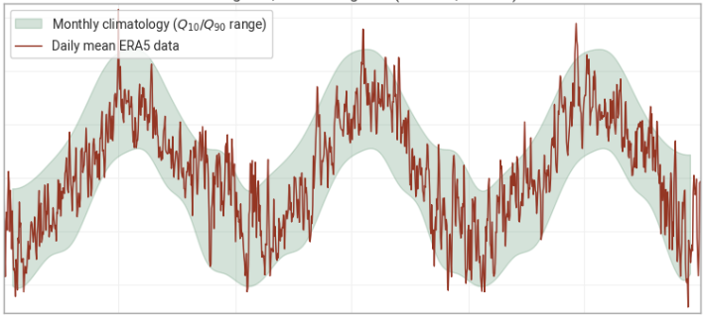
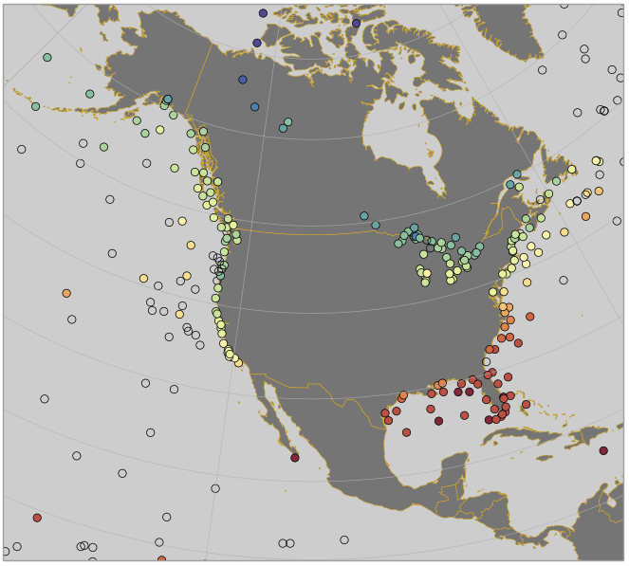
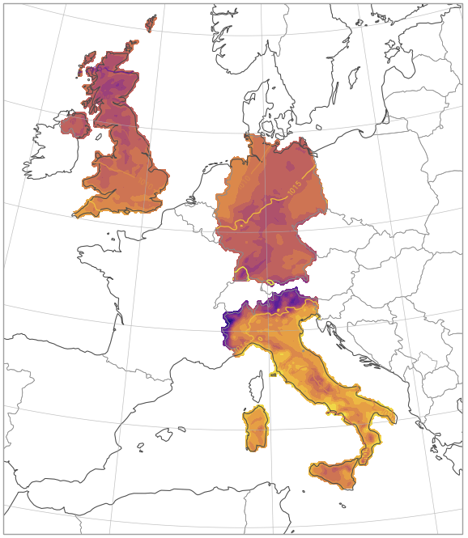
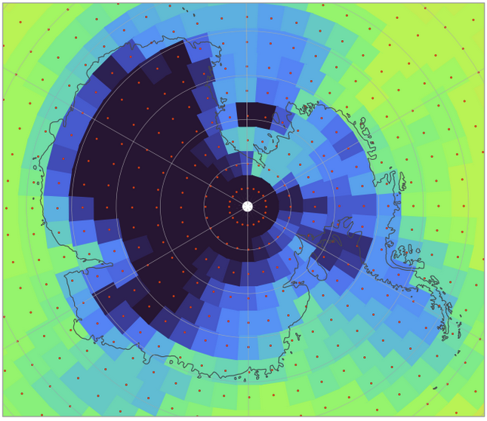
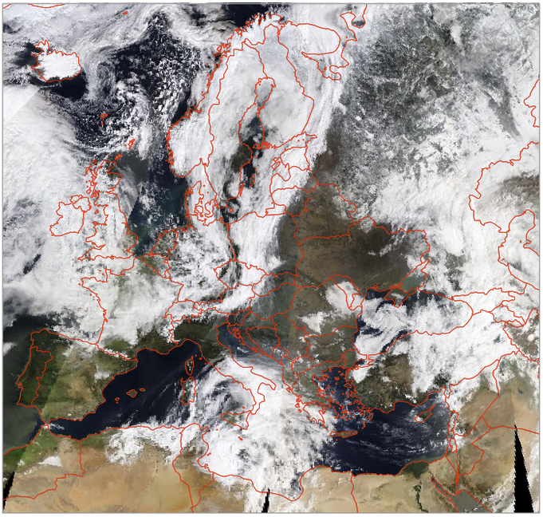
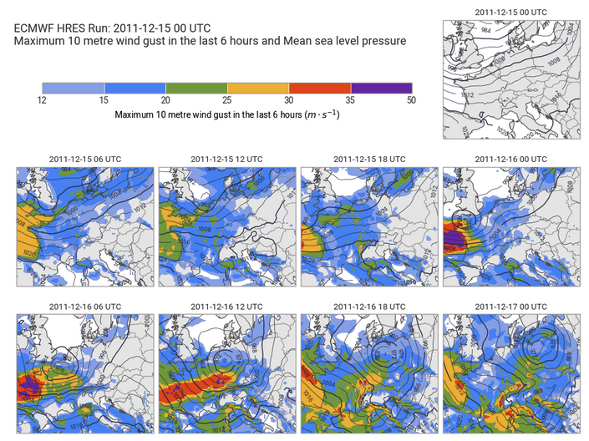
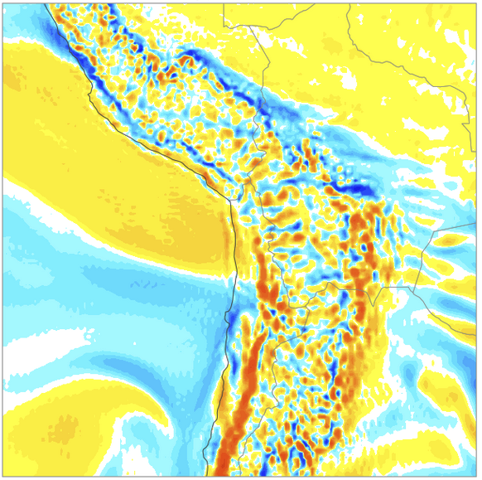
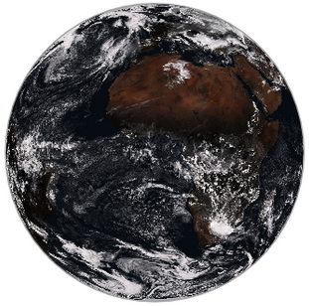
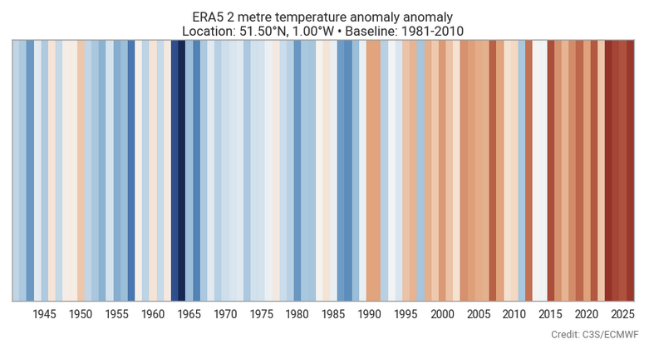
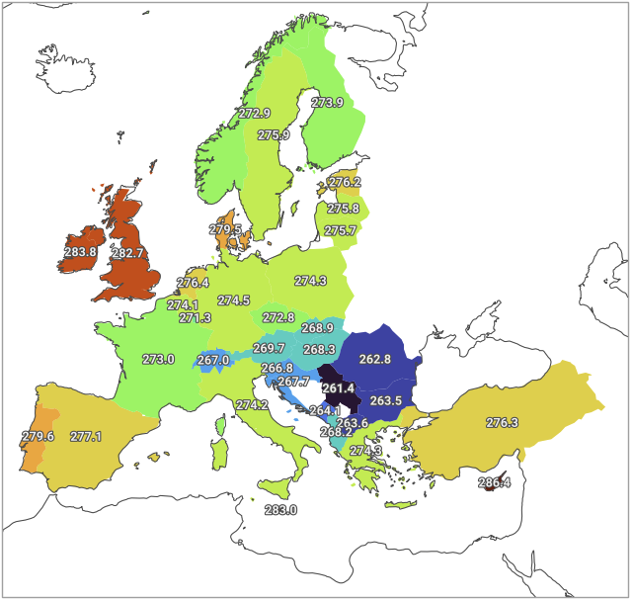
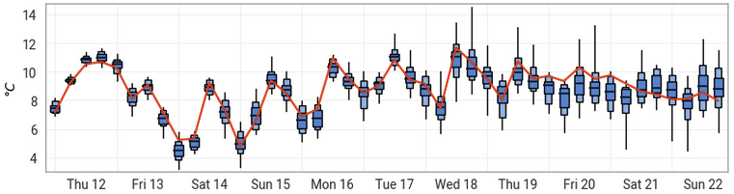
earthkit-plots provides high-level methods for many kinds of weather and climate visualisations

