Slide 1
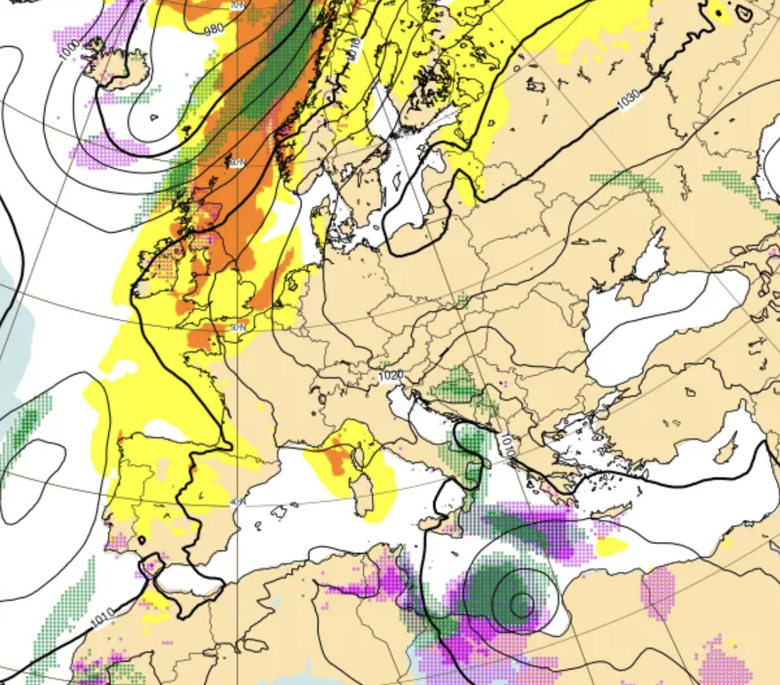
Earthkit-meteo introduction
Earthkit 1.0 training
Development Section

Slide 2
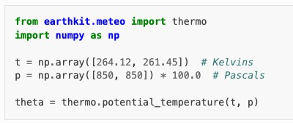
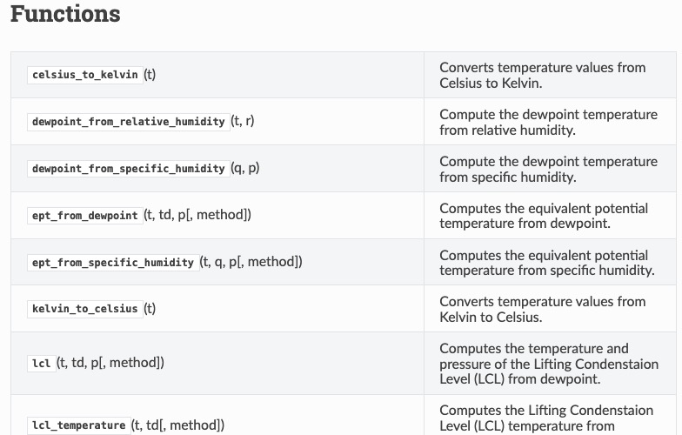
The earthkit module for meteorological functions
Many submodules
Thermo
Wind
Score (linking with scores library)
Extreme (EFI, SOT, etc.)
Stats (Gumbel distribution, etc.)
Vertical
Solar
Regimes
… and more to come!
Notes:
Most dependencies are optional, so you don’t have to install them unless you need them

Slide 3
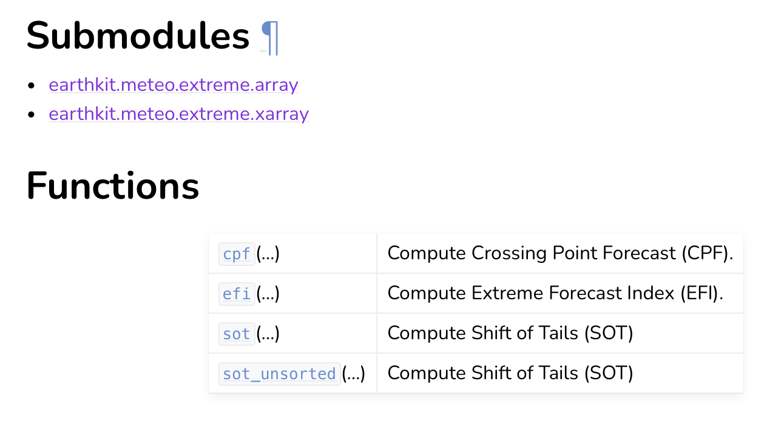
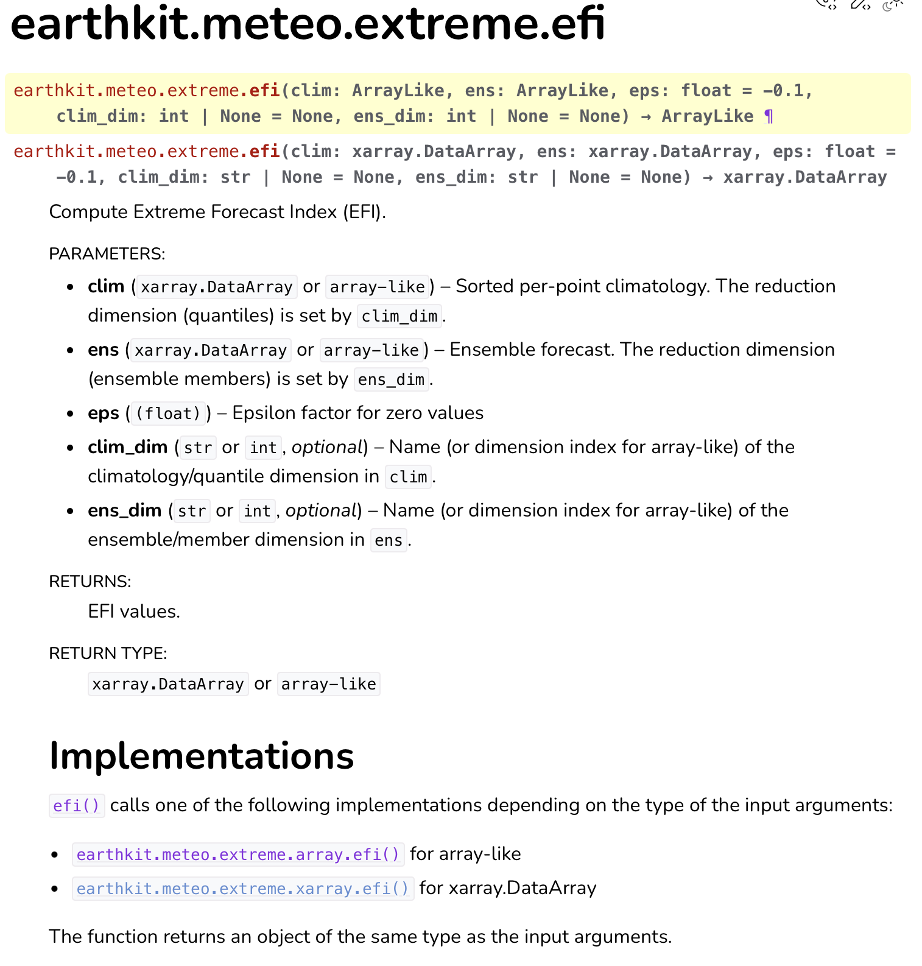
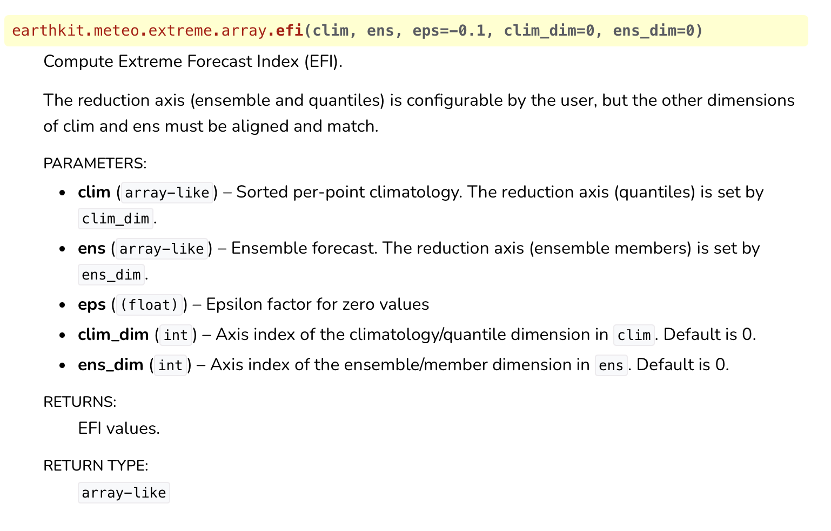
What’s new in Earthkit-meteo 1.0?
Main change: implementation of high-level API
Philosophy: we don’t know what workflow and data model user will use… so we decided to support them all!
Implementation:
  Low-level function implementation: Array standard (Cupy, Torch, …), Xarray, FieldList (in construction)
  High-level API will dispatch automatically to low-level based on data type
  Users can still directly point to low-level implementation if they want to
Next step: support metadata

