Slide 1
Earthkit-geo introduction
Earthkit 1.0 training
Development Section

Slide 2
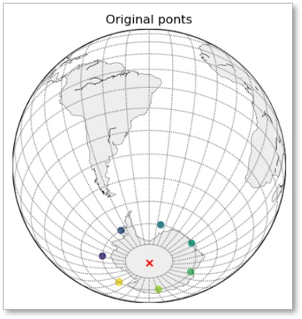
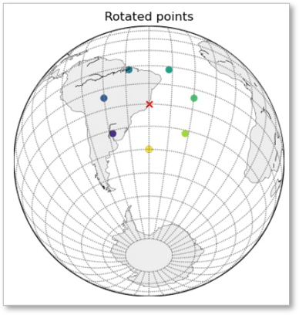
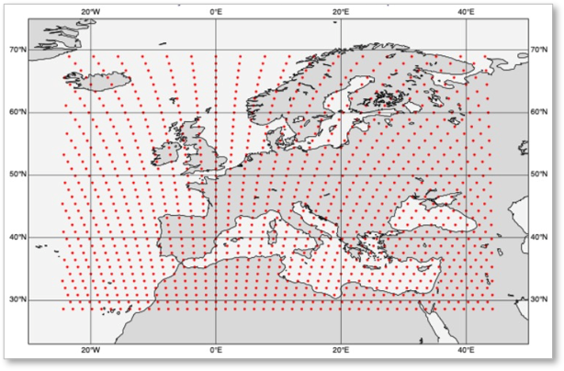
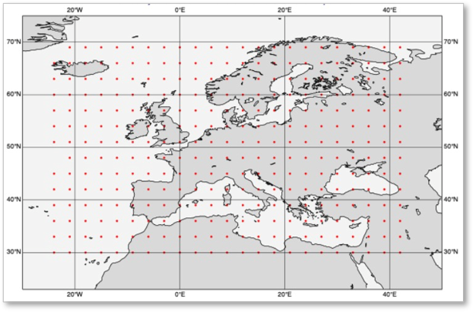

earthkit-geo
earthkit-geo is a Python package providing geospatial computations.
Coordinate conversion
Point rotation (around a shifted pole)
Distance computations
GISCO region polygons
Regridding (functionality was previously in earthkit-regrid)
https://earthkit-geo.readthedocs.io/en/latest/index.html

