Slide 1
Earthkit - extras
Earthkit 1.0 training
Development Section

Slide 2
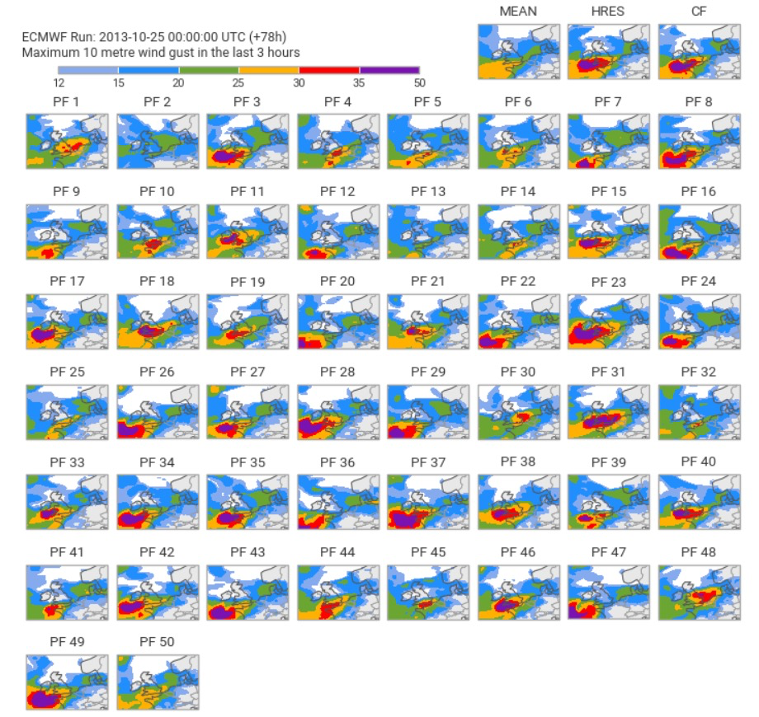
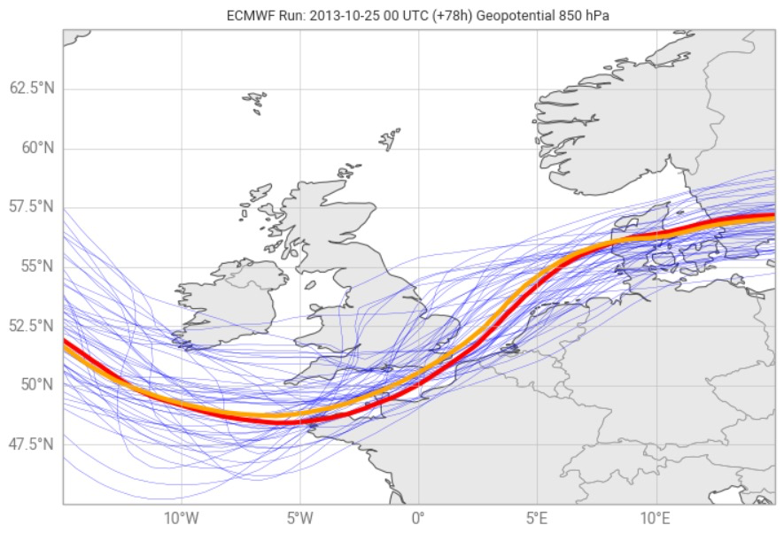
extras
Currently just one extra notebook to look at
Concentrates on ensemble data
Utilises both FieldList and xarray representations of the data

Slide 3
And finally...
Comments on Earthkit
  Do the APIs seem consistent and well thought out?
  Could you do what you need to do with it?
  Will it be useful in your work?
  Would you consider contributing to it?

