Slide 1
Earthkit-data introduction
Earthkit 1.0 training
Development Section

Slide 2
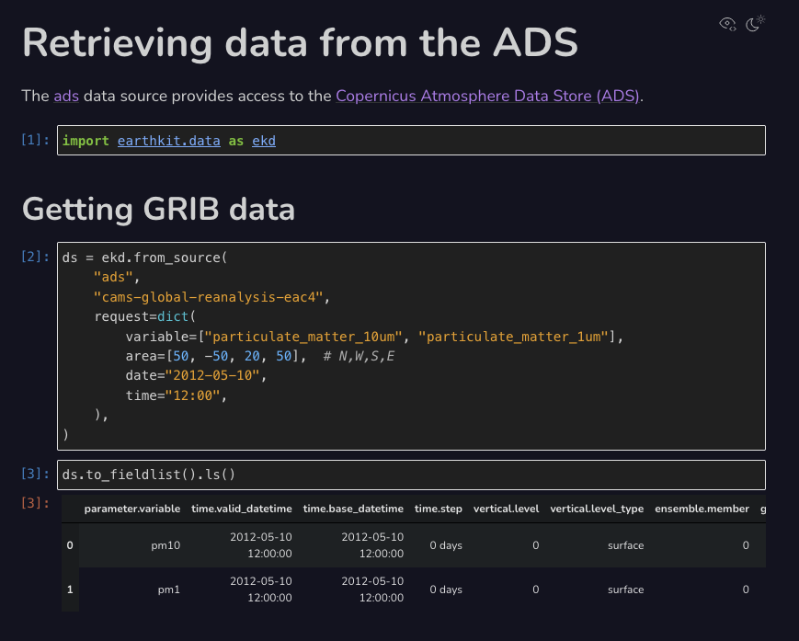
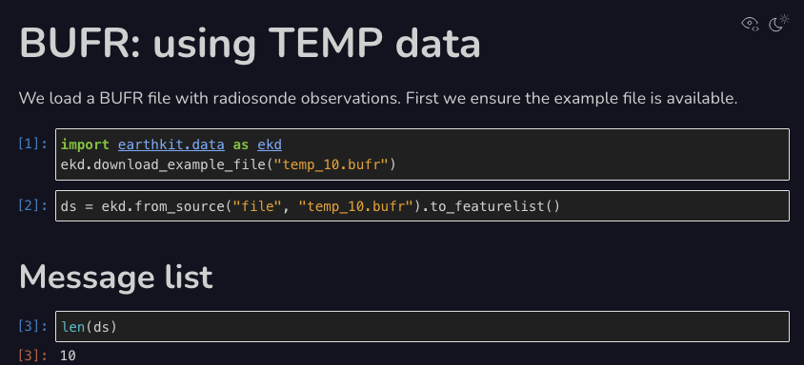
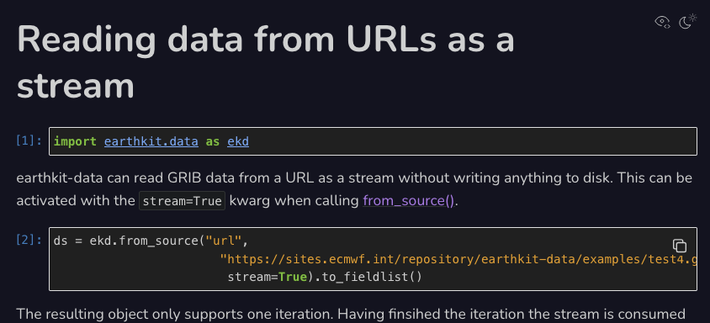
earthkit-data
Retrieves data (GRIB, BUFR, NetCDF, ODB, …) from sources such as
  MARS and the CDS, ECMWF Opendata
  FDB memory stream
  files and URLs
Conversion: e.g. GRIB to Xarray
Writing to targets
Provides input for the other earthkit components
https://earthkit-data.readthedocs.io/en/release-1.0.0rc0/index.html

Slide 3

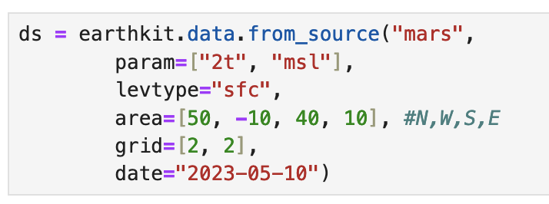
Getting the data
The method to use is from_source():

Slide 4
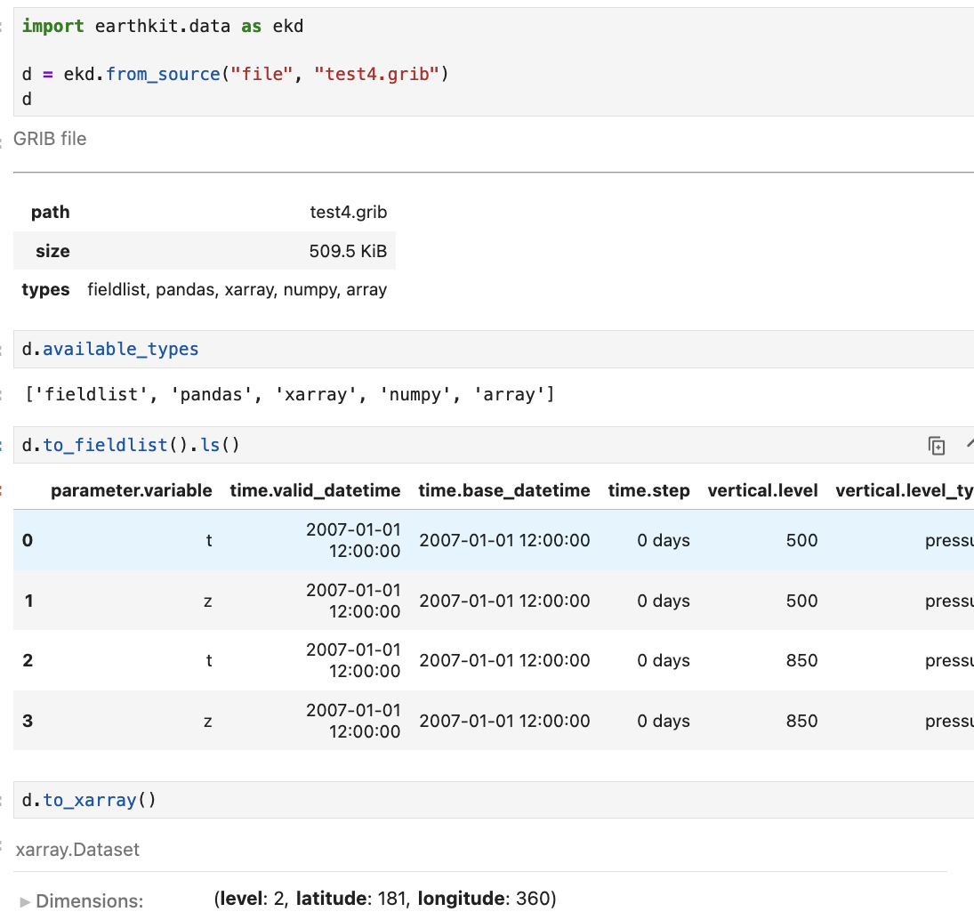
Conversions
from_source() does not load the data but returns an object with some basic information and conversion methods
Then we need to choose the best representation for our work and convert the data e.g. with:
to_fieldlist()
to_xarray()
to_pandas()

Slide 5
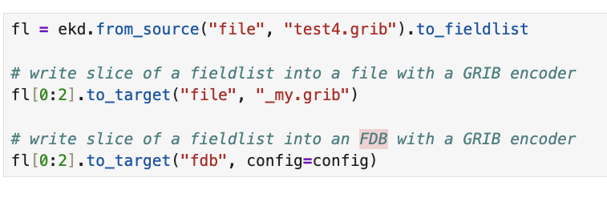
Targets and encoders
to_target() can write the data into target with a suitable encoder

