Slide 1
Earthkit introduction
ECMWF, Forecasts & Services Department, Development Section

Slide 2

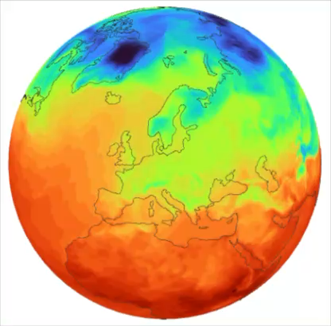
Introducing
Earthkit
  New set of high-level scalable, interoperable, focused Python components
  Suitable for use by our operational services and directly by researchers / analysts
  Designed with Machine Learning / GPU / In-memory computations as first-class citizens
  Designed with diskless data access in mind
  Reduce boilerplate code
  Components are in different stages of maturity, but some already in operational use at ECMWF and version 1.0 is coming very soon for most of them!
Open Development
  Highly collaborative both inside and outside ECMWF
  All code is on GitHub, fully embracing Open Development
earthkit.ecmwf.int
Notes:
Most dependencies are optional, so you don’t have to install them unless you need them

Slide 3

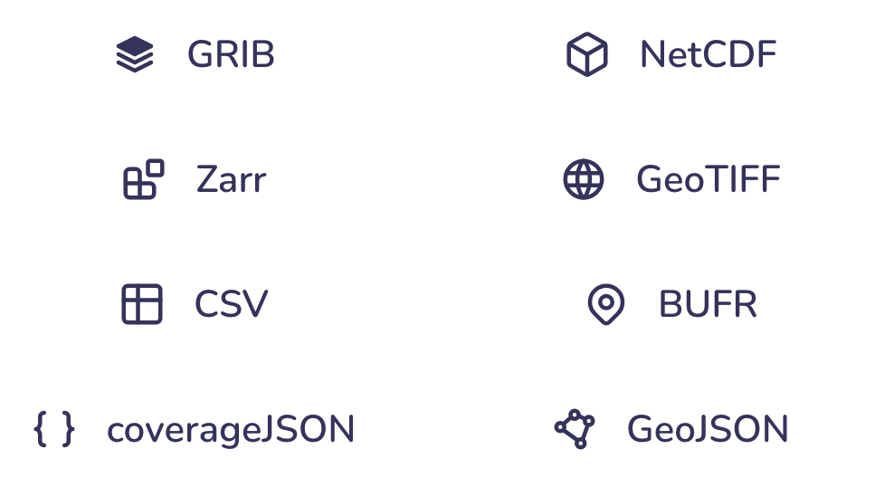





Introducing
Interoperable with essential Python packages
Integration with a wide range of data formats

Slide 4
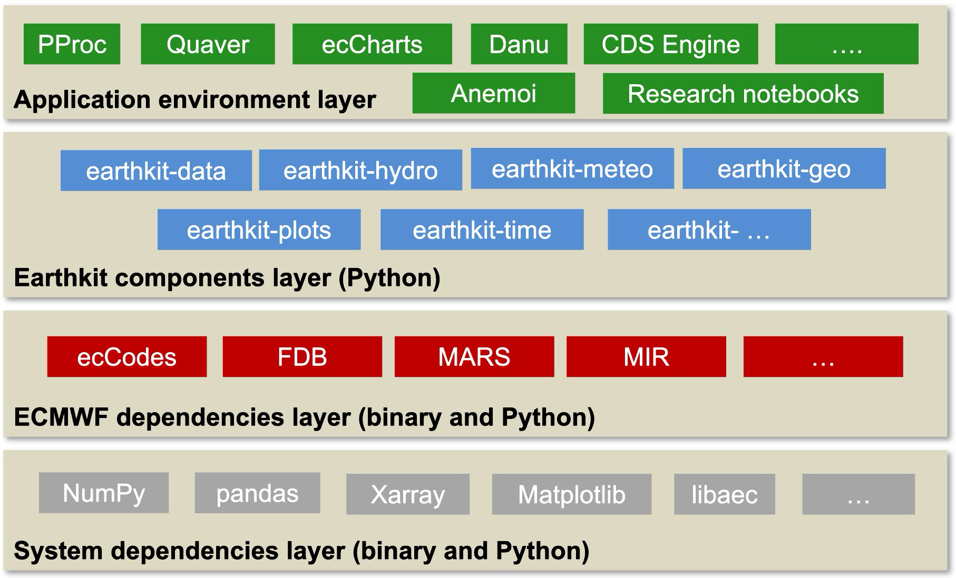
Introducing Earthkit
Part of the modernization of the ECMWF software stack
Earthkit will replace Magics and Metview in terms of processing and plotting
Earthkit Studio™, a long-term project, will replace Metview's user interface and ecCharts
Notes:
Most dependencies are optional, so you don’t have to install them unless you need them

Slide 5
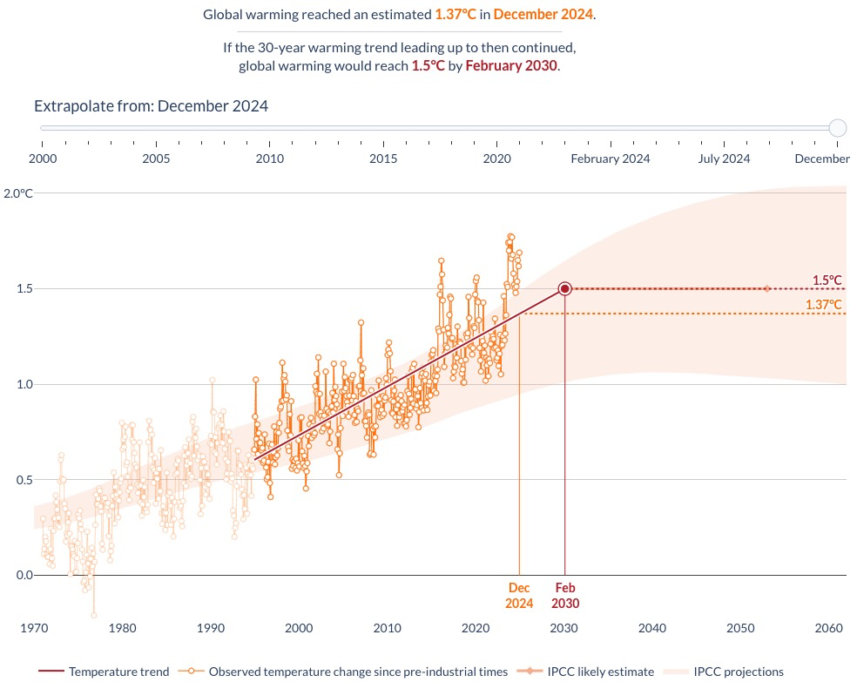

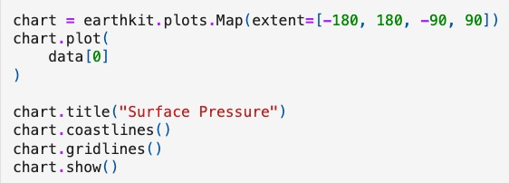
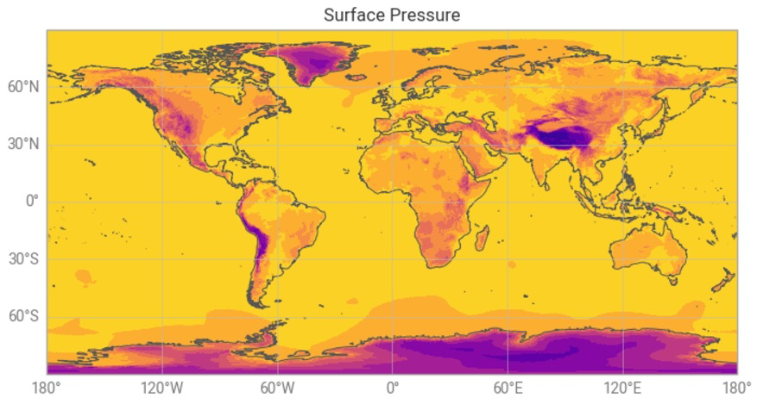
Examples usages today
The Anemoi machine learning framework (data handling and plotting)
ECMWF's post-processing suite (data and time handling, thermodynamic computations)
Forecast-in-a-box (data handling, workflows, plotting)
ecCharts (data handling)
Recommended way to retrieve and visualise Destination Earth Digital Twin data via polytope
Copernicus web applications, e.g. C3S Global Temperature Trend Monitor; on-the-fly aggregation of daily statistics; recommended way to access and process CDS datasets
Notes:
Most dependencies are optional, so you don’t have to install them unless you need them

Slide 6
Version 1.0.0 and what it means
We are preparing for a version 1.0 release of Earthkit
  This means a more stable API
    No sudden removal or renaming of functions or arguments
    Some functions may be marked 'experimental' (docs & warnings), providing a means to allow user testing before finalising them
  We have been releasing 'release candidates' with versions such as 1.0.0rc1 to allow easy testing
Earthkit 1.0 contains some big API changes compared to earlier versions, so many user scripts are expected to need to be updated
This training session - allows interested users to get some hands-on with Earthkit and – feedback on Earthkit's API and its documentation are welcome; this is an opportunity to help shape the future direction
Actual release of Earthkit 1.0 in mid/late-May, depending on YOUR feedback!
Thank you all for taking part!
Notes:
Most dependencies are optional, so you don’t have to install them unless you need them

Slide 7

Earthkit and its components
https://earthkit.ecmwf.int/

Slide 8
This course will introduce:
https://earthkit.ecmwf.int/

Slide 9
Installation
The Earthkit Python components are on PyPi
  Can be installed with pip install earthkit-data; pip install earthkit-plots etc
    We make use of optional components, e.g. pip install 'earthkit-data[geotiff,mars]' (or [all])
  All packages can be installed in one go with pip install earthkit
Earthkit's binary dependencies are also on PyPi
  We have a fairly new system of distributing binary Python packages
  e.g.
    pip install eccodes gives you the Python interface
    pip install eccodeslib gives you the binary library
  Earthkit will ensure that the proper dependencies are installed, but some may come as optional components
  It is possible to use binaries (e.g. ecCodes, MIR, ...) from elsewhere – see the findlibs readme
    https://github.com/ecmwf/findlibs
Notes:
Most dependencies are optional, so you don’t have to install them unless you need them

Slide 10
Earthkit technical setup for training
ECMWF, Forecasts & Services Department, Development Section
Iain Russell

Slide 11

Setup environment
You should be able to try the examples in this course either on your Macbook laptop or from a Jupyterhub session on ATOS
If choosing Jupyterhub/ATOS, we assume you already know how to use it :)
Get the training repo (we assume you will put it into $HOME/training but it's up to you – on ATOS it's best to ensure it's close to $HOME)
mkdir $HOME/training
cd $HOME/training
git clone git@github.com:ecmwf-training/2026-earthkit-training.git #OR
git clone https://github.com/ecmwf-training/2026-earthkit-training.git
cd 2026-earthkit-training
Follow the setup instructions in README.md (repeated on these slides)
Notes:
Most dependencies are optional, so you don’t have to install them unless you need them

Slide 12
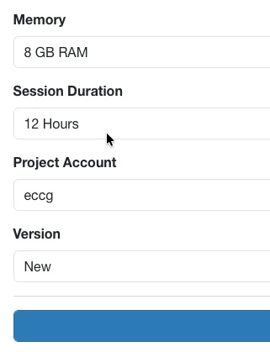

Setup environment
JupyterHub/ATOS
  Go to https://jupyterhub.ecmwf.int/
  Choose "Version : New" on the config page
Macbook or other system that is not ATOS:
Create a virtualenv:
python3 -m venv ./earthkit-venv
source ./earthkit-venv/bin/activate
pip3 install -r ./requirements.txt
Launch jupyter:
jupyter lab
From Jupyter, navigate to
  $HOME/training/2026-earthkit-training/content
Notes:
Most dependencies are optional, so you don’t have to install them unless you need them

Slide 13
Introducing Earthkit
Application environment layer
PProc
Quaver
ecCharts
Danu
CDS Engine
….
Anemoi
Research notebooks
Earthkit components layer (Python)
earthkit-data
earthkit-hydro
earthkit-meteo
earthkit-geo
earthkit-plots
earthkit-time
earthkit- …
ECMWF dependencies layer (binary and Python)
ecCodes
FDB
MARS
MIR
…
System dependencies layer (binary and Python)
NumPy
pandas
Xarray
Matplotlib
libaec
…
Notes:
Most dependencies are optional, so you don’t have to install them unless you need them

